Slide 1
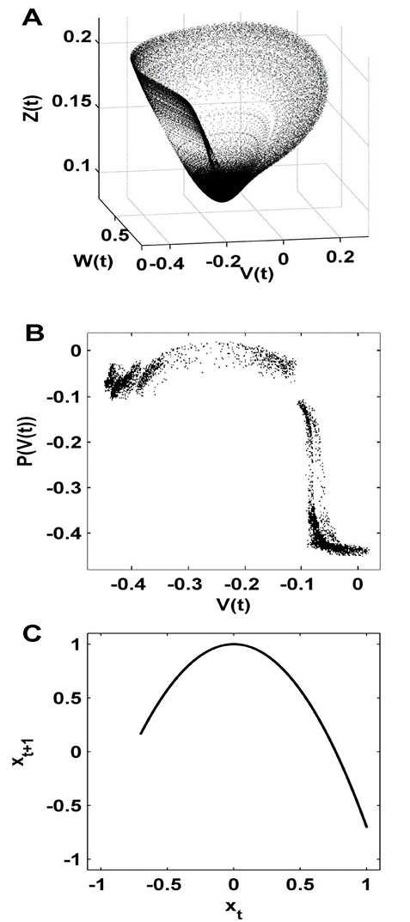

Figure 1. From Rubinov et al., 2009. Dimension reduction of nonlinear neuronal dynamics. (A). Phase space attractor of a three-dimensional neural mass flow. This attractor is an illustration of the dynamics generated by the flow of a neural mass model (see Breakspear et al. [33]). The dynamical variables represent the mean membrane potential of pyramidal (V) and inhibitory (Z) neurons, and the average number of open potassium ion channels (W). (B). Poincaré first return map from the same attractor [33]; this map captures key features of the neural mass flow, by following each trajectory from one intersection (V) of the attractor to the next (P(V)). (C). The quadratic logistic map. This map has the same unimodal topology as the neural mass Poincaré return map. While the logistic map lacks the "thickness" of the neural mass map, it is several orders of magnitude faster to compute, hence allowing the detailed quantitative analysis in the present paper.

Slide 2
Figure 2. Feigenbaum diagrams.

Slide 3
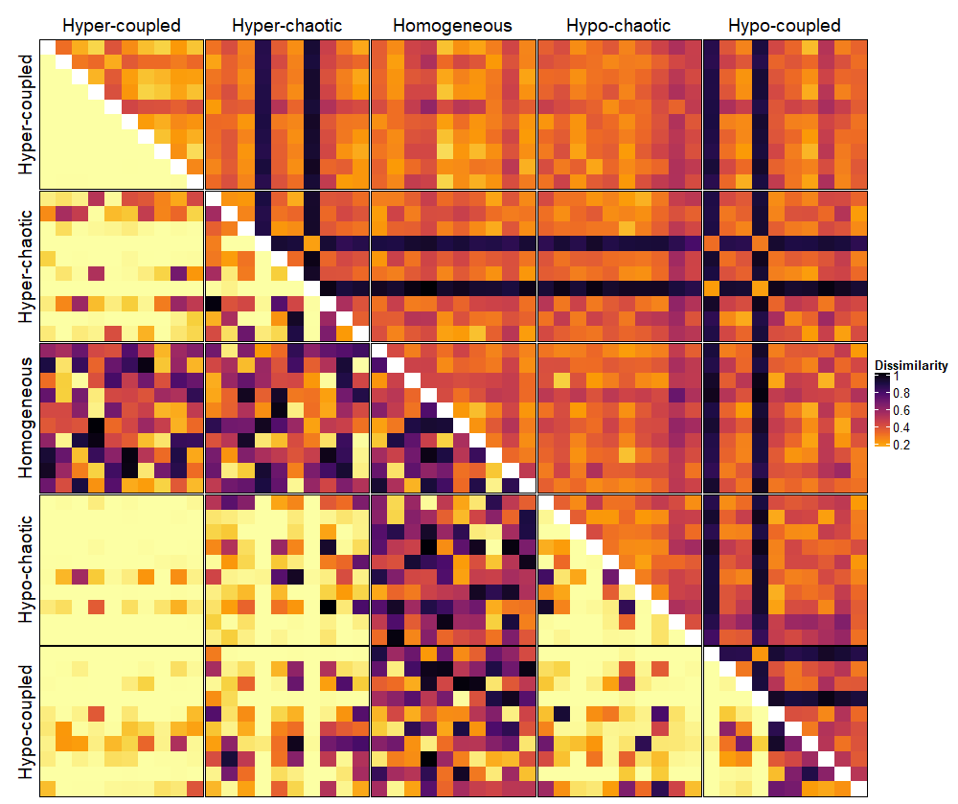
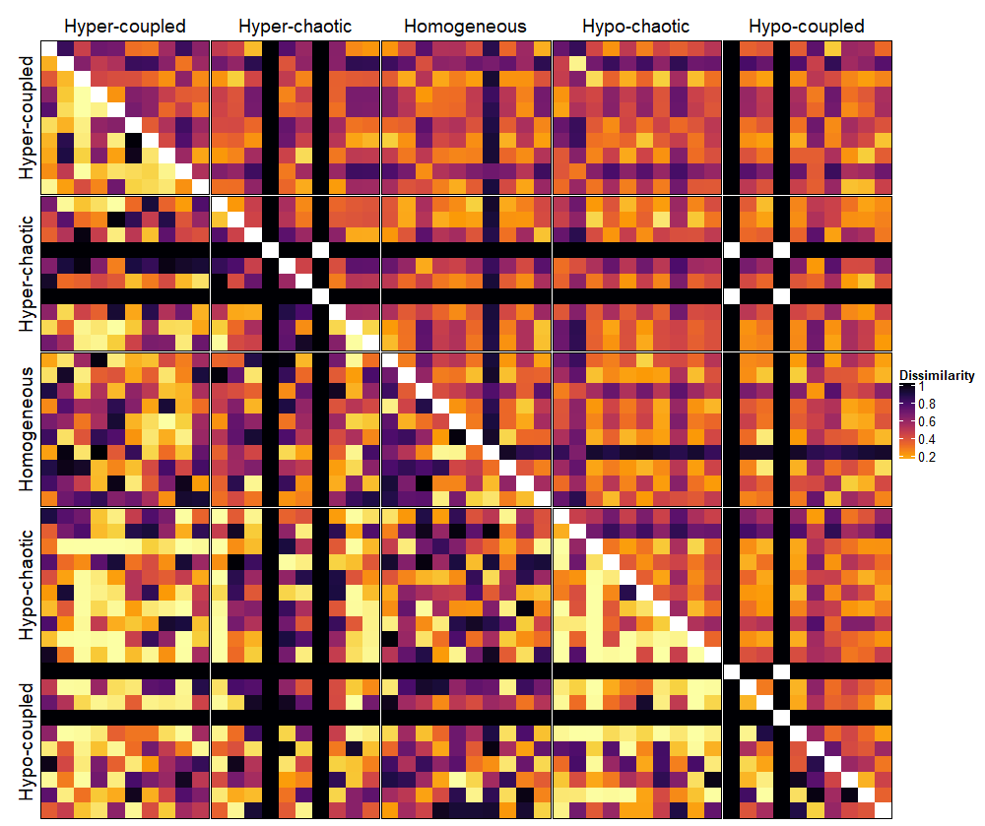
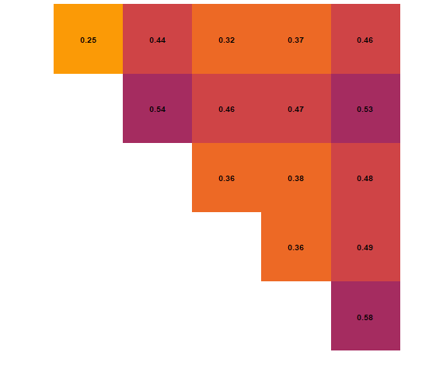
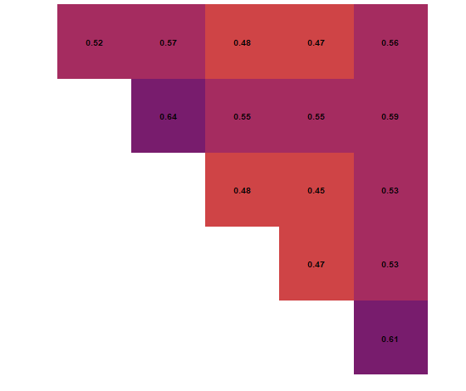
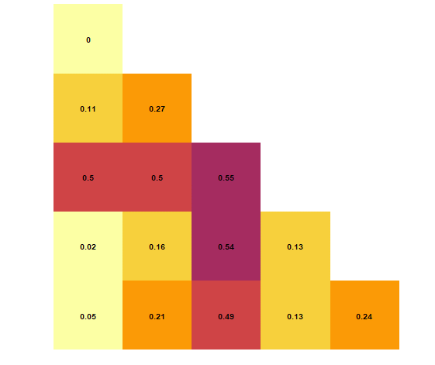
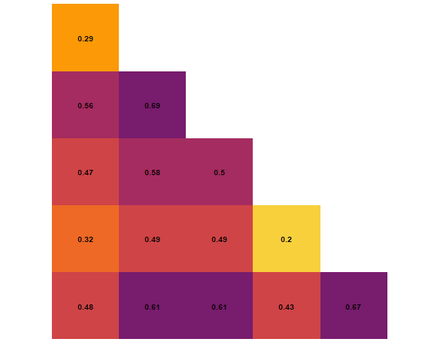
Connectivity
Activity
NetSimile Signature
HHG

Slide 4
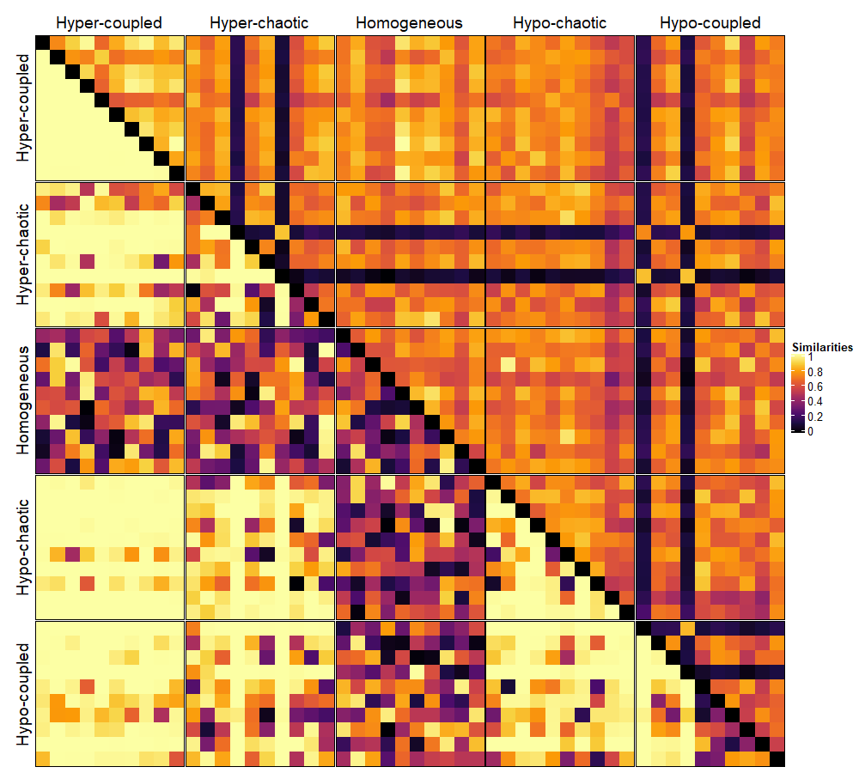
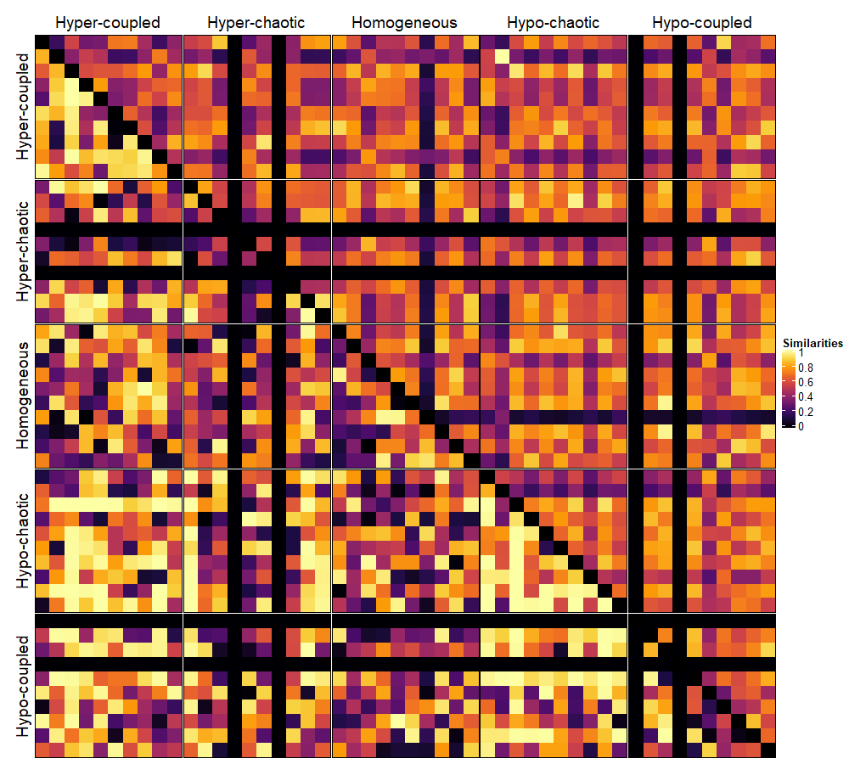
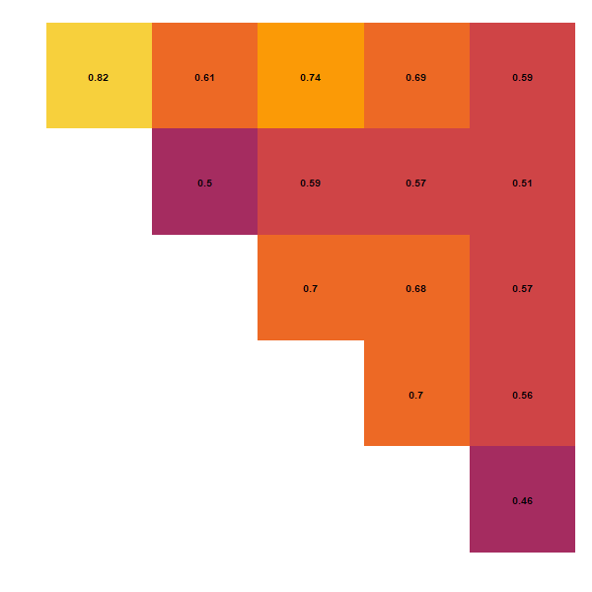
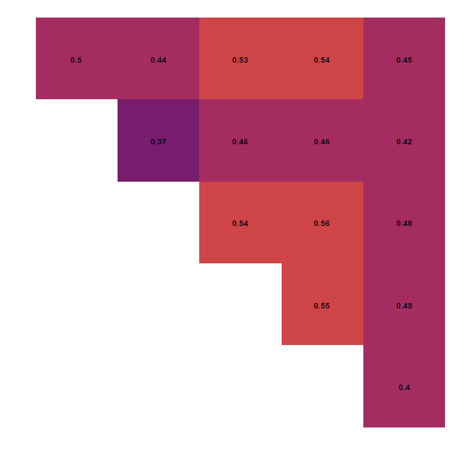
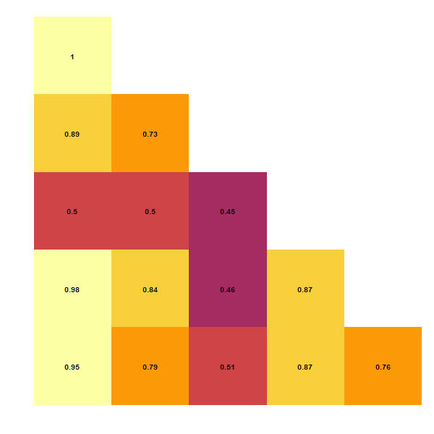
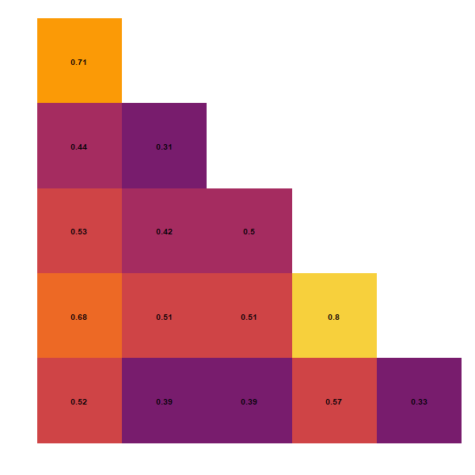
Anatomical
Functional
NetSimile
HHG

Slide 5
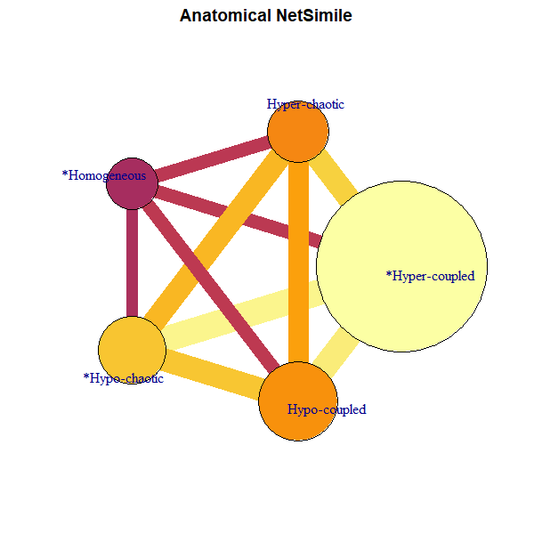
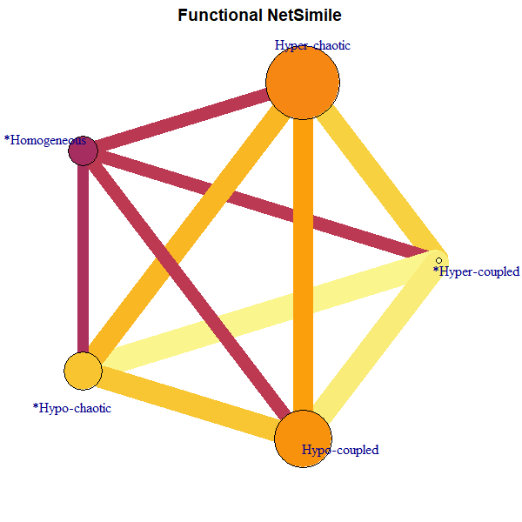
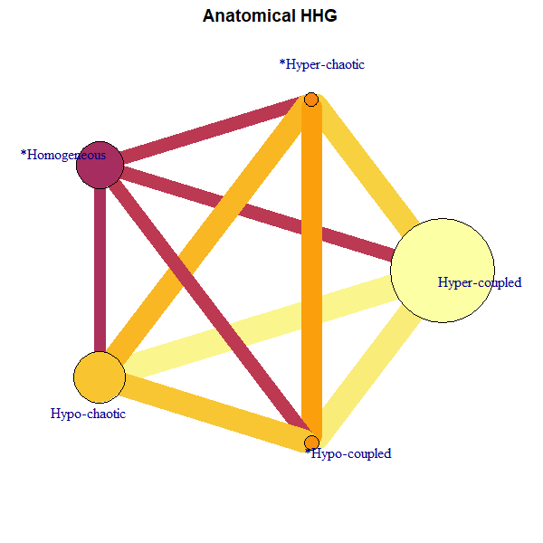
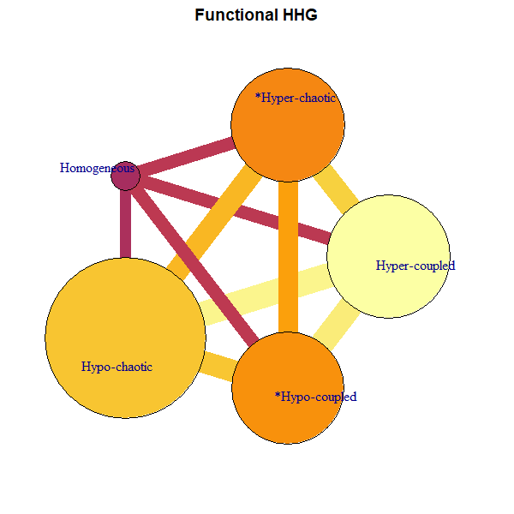

Slide 6
